Slide 1

Brighter Futures Project
Consequences and Unexpected Consequences of a GG
April 14, 2021

Slide 2
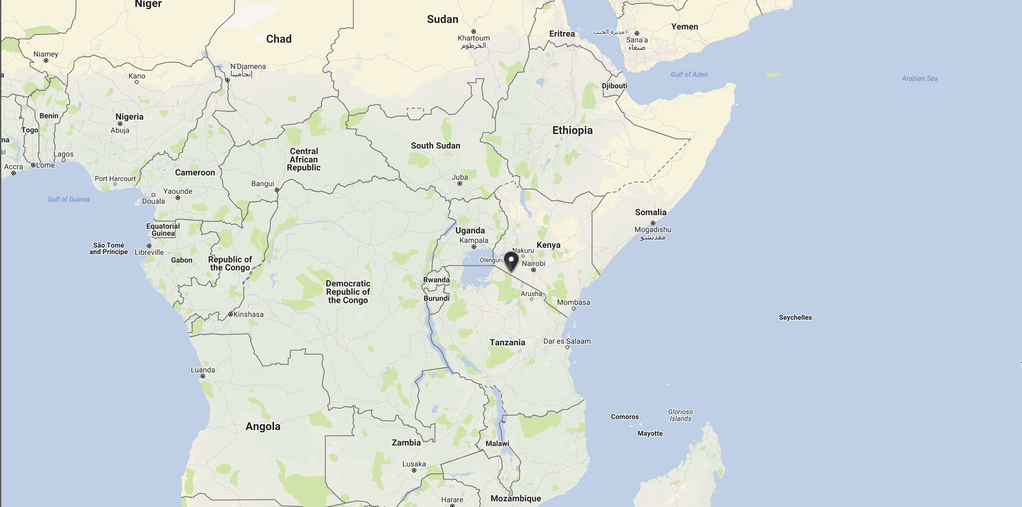
… where are Nkoilale, Kisiriri and lltumaro?

Slide 3


Rotary GG # 1756130

Slide 4
renovate 15 classrooms
(desks - doors - windows - lighting - floor - wall)
build 40 toilets (14 girls, 14 boys, 4 teachers
8 infants)
build 2-350,000 ltr. rainwater harvesting systems

Slide 5
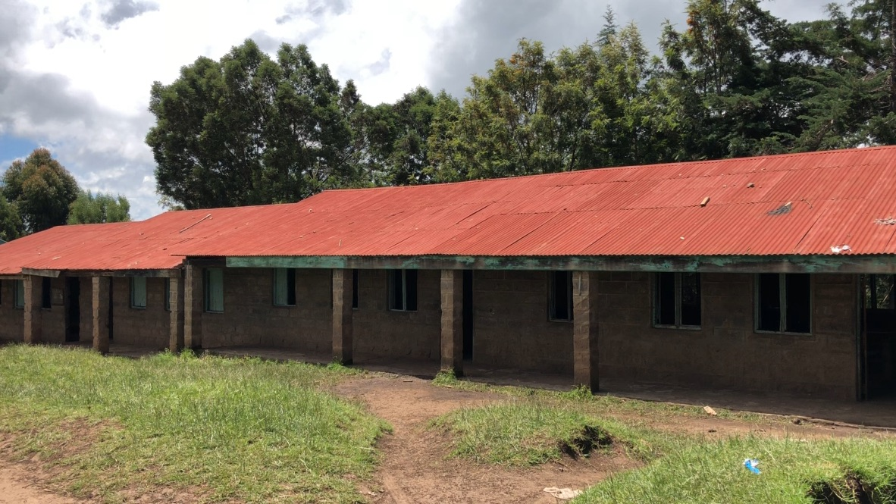
… before – roof leaked - painted with lead paint

Slide 6
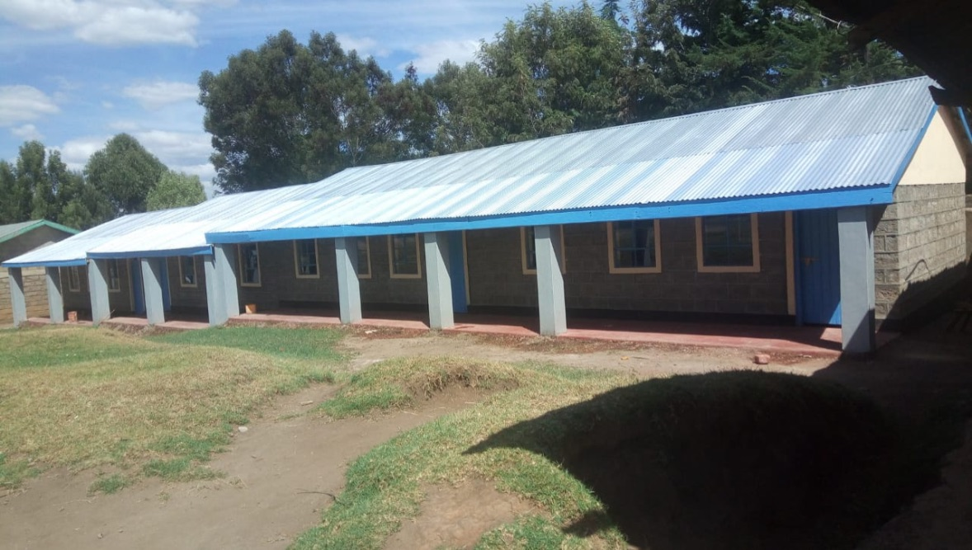
… a new roof

Slide 7
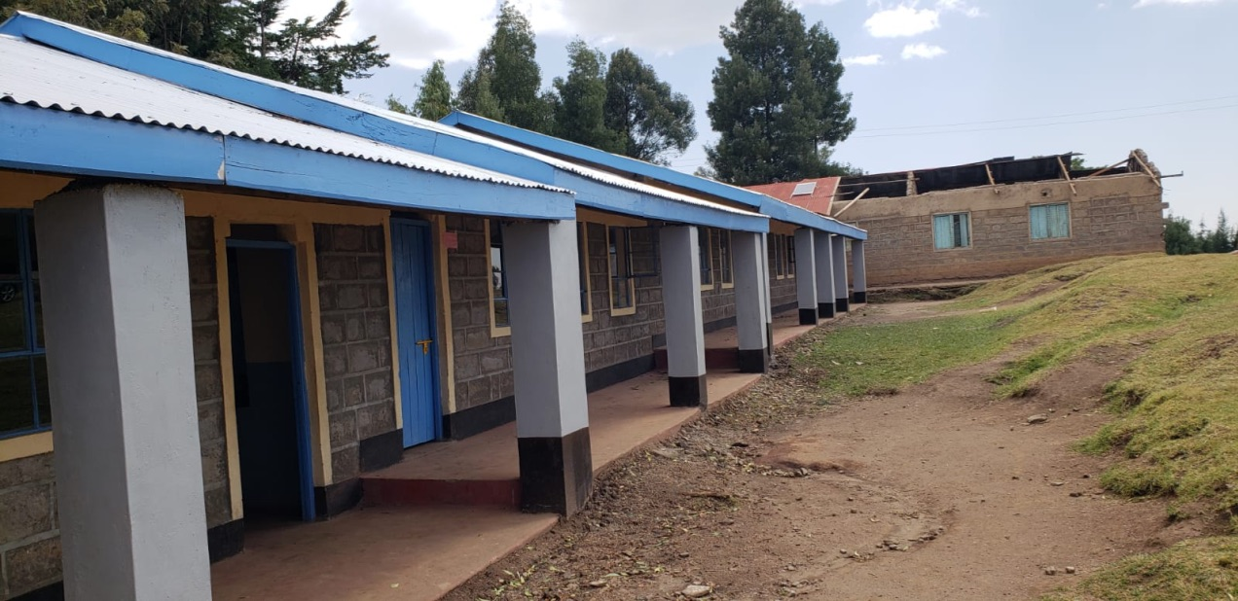
… roof lost in a wind storm
… building without a roof is now a library

Slide 8
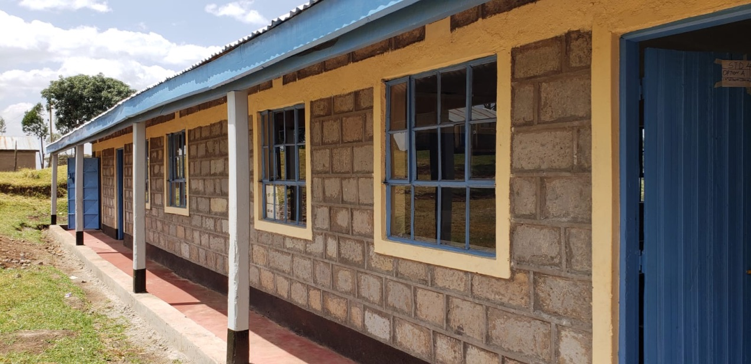
… after

Slide 9
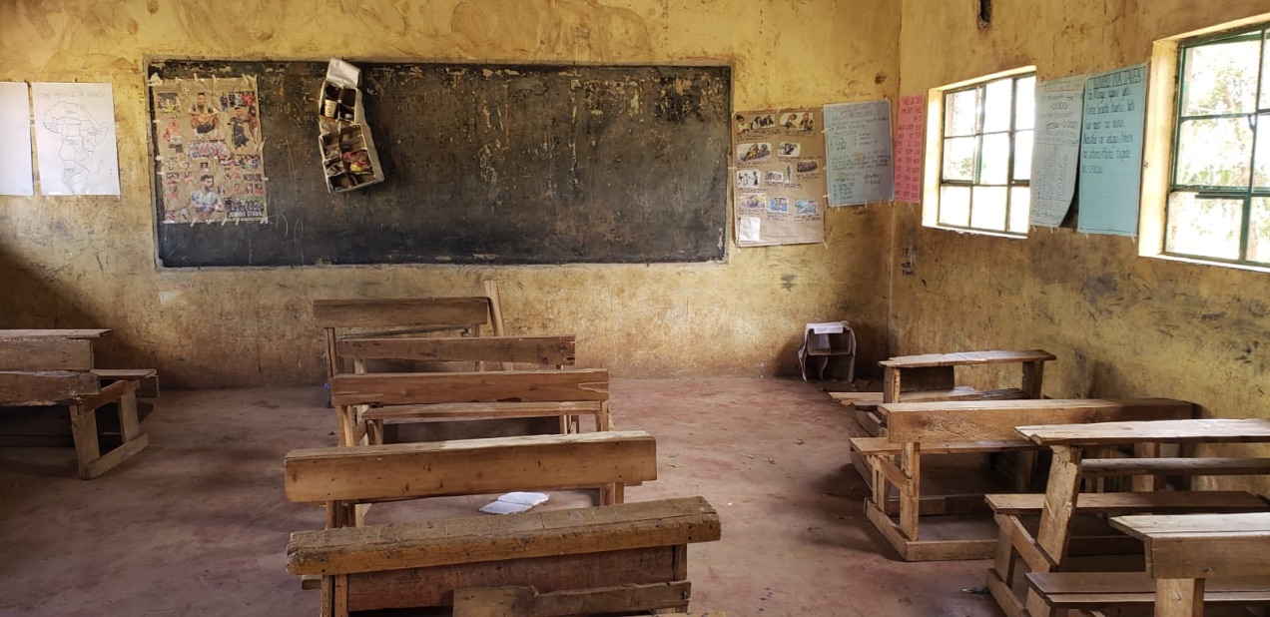
… we started with this

Slide 10
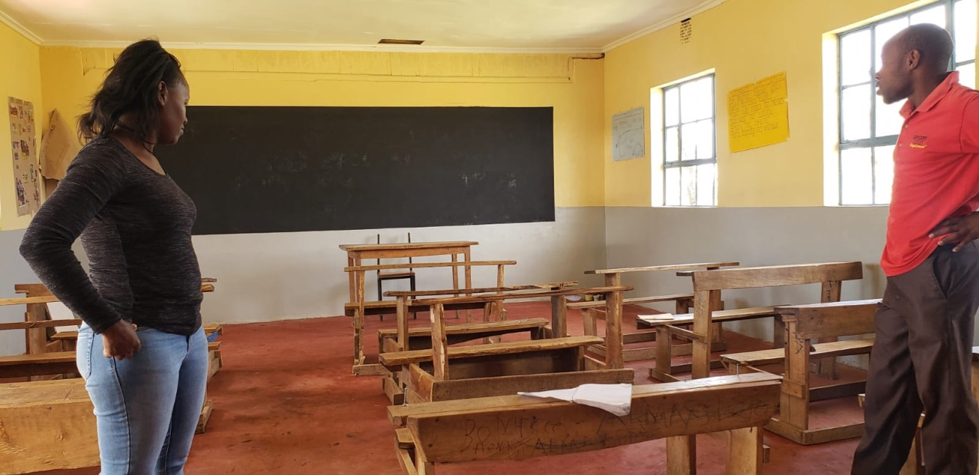
… and ended with this

Slide 11
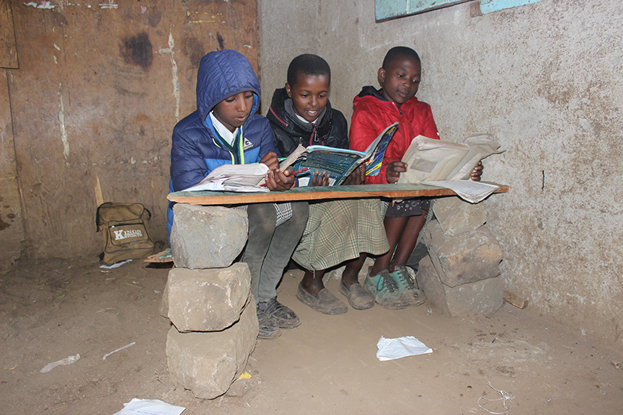
… many school desks are primitive and unsafe

Slide 12
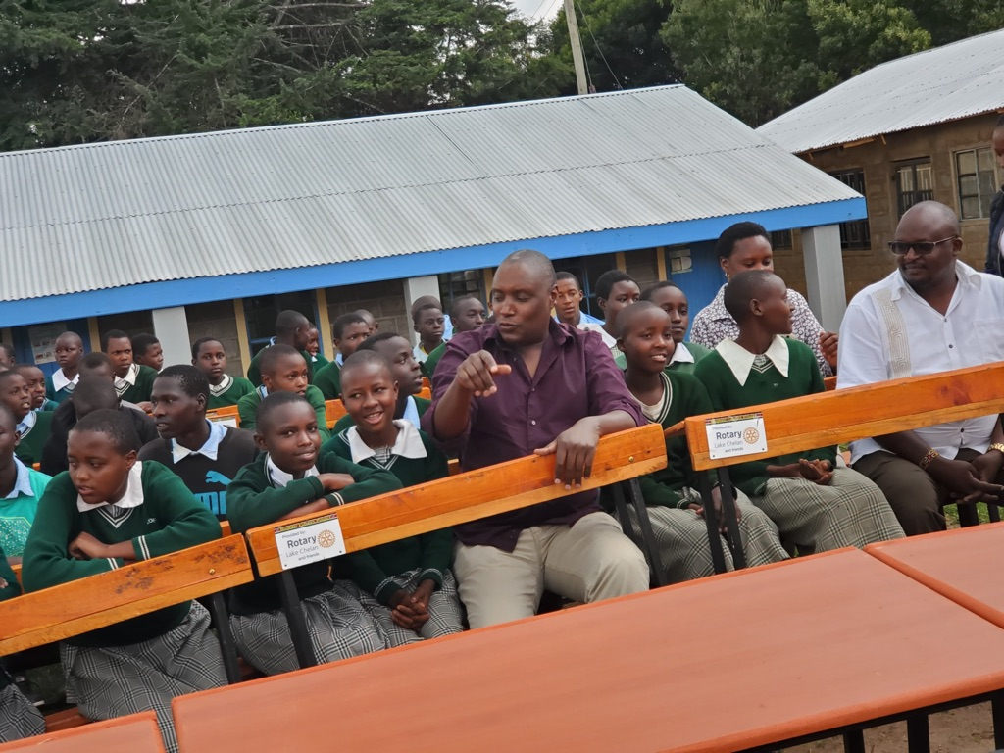
… we have delivered 100 new desks

Slide 13
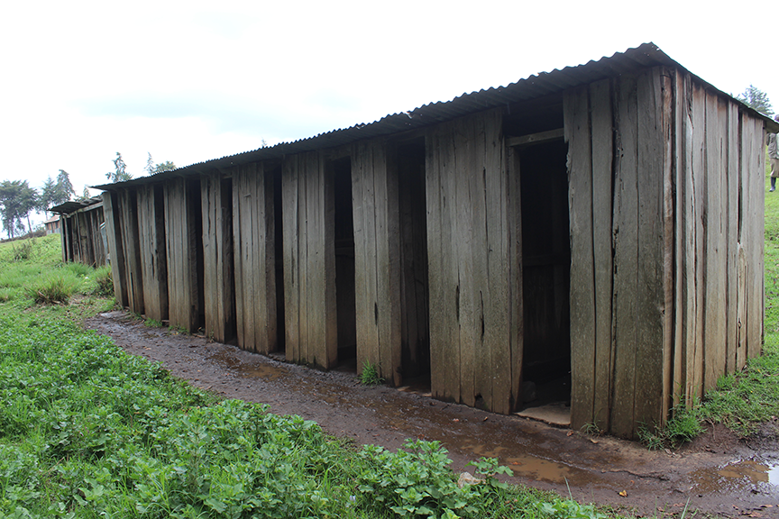
… these where the existing toilets

Slide 14
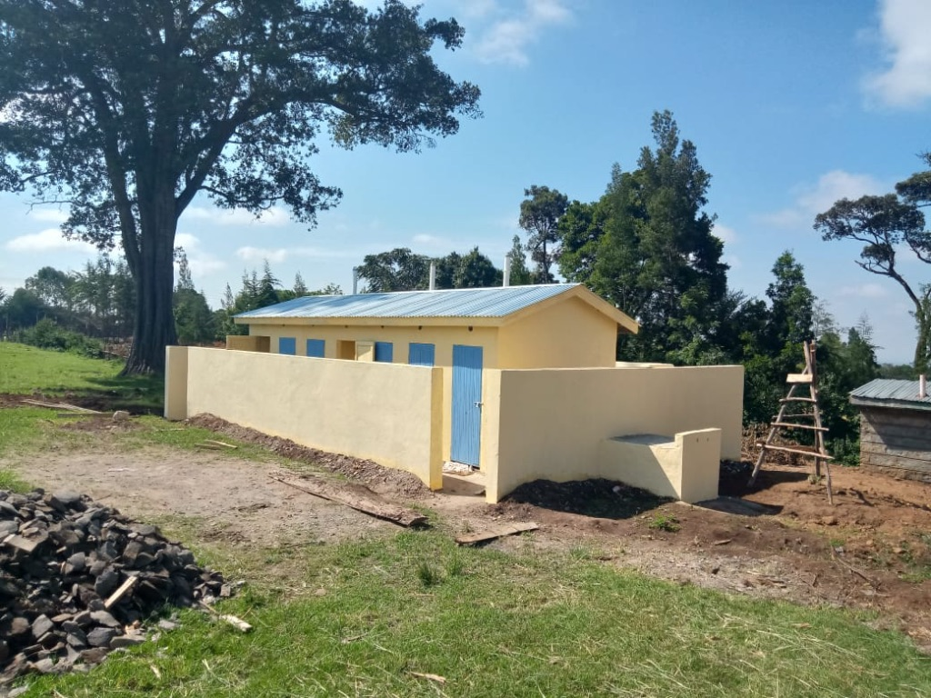
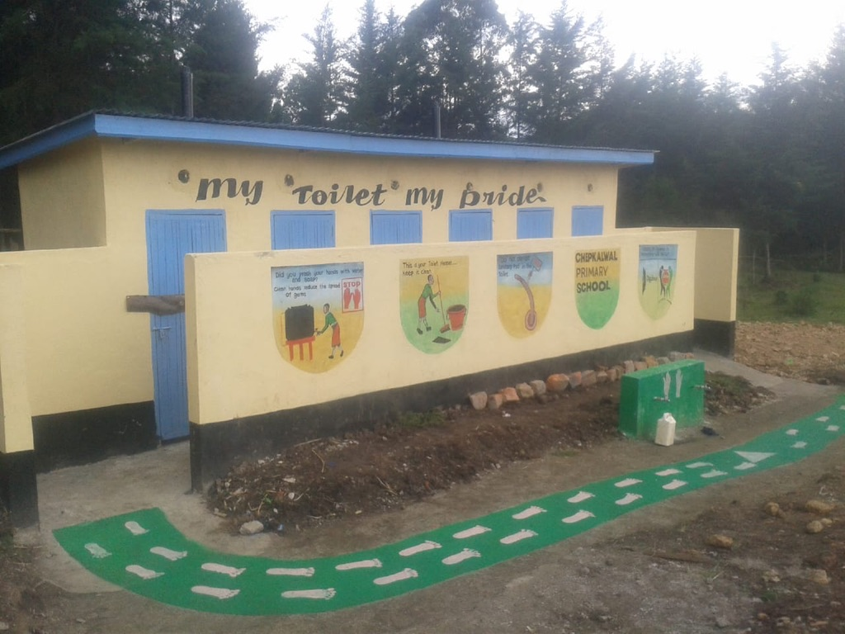
… new toilets now in use

Slide 15
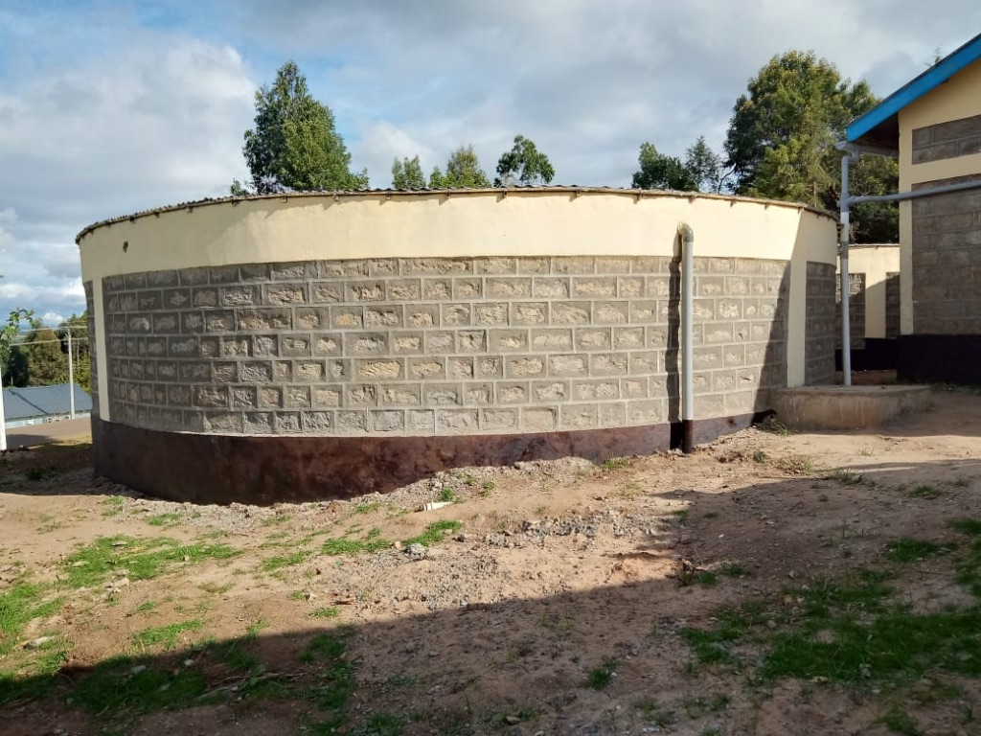
… water tanks are full

Slide 16
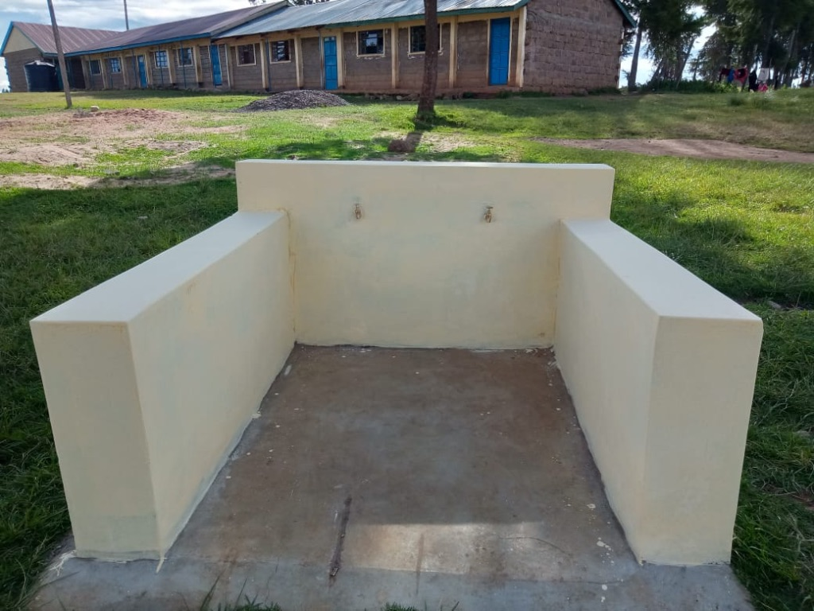
… students tap stand

Slide 17
Consequences

Slide 18
national testing scores have improved by 15 points
number of students attending school has increased
from 629 to 854
girls staying at home during their period has been reduced from 90% to 5%,

Slide 19
absenteeism is down by 75%
a library has been built
a student health club has been established
an environmental club has been established

Slide 20
Unintended Consequences

Slide 21
established three school libraries
established a sewing program for young women
established welding program for young men
developed computer training lab
ongoing tree planting program

Slide 22
a new Rotary club has been chartered
feeding program for the sick and elderly
student recognition program established
primary school mentorship program

Slide 23
StoryBook Libraries

Slide 24
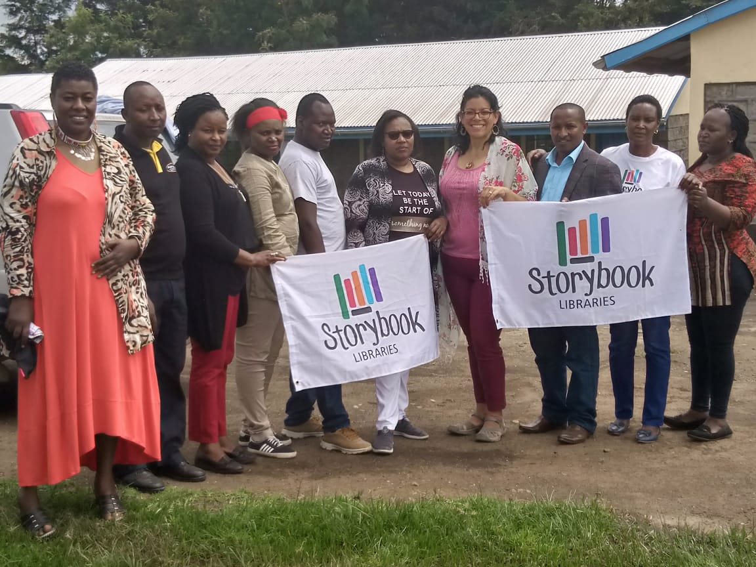
… this was the beginnings of a Rotary Club

Slide 25
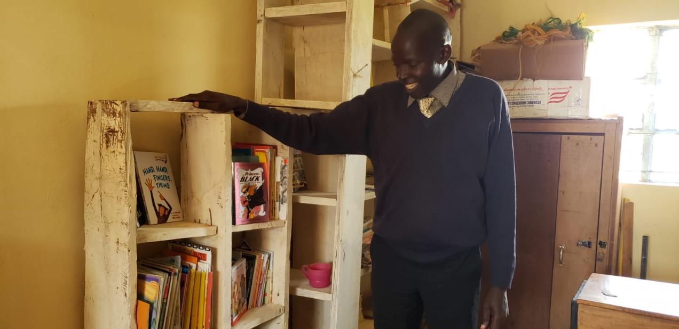
… this was the Kisiriri school library

Slide 26
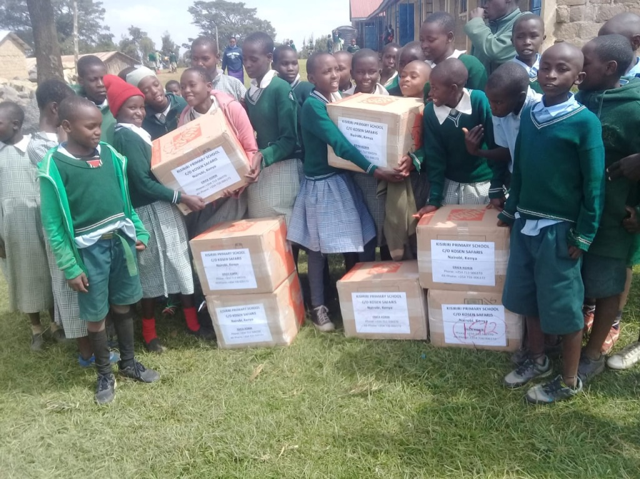
… the initial shipment

Slide 27
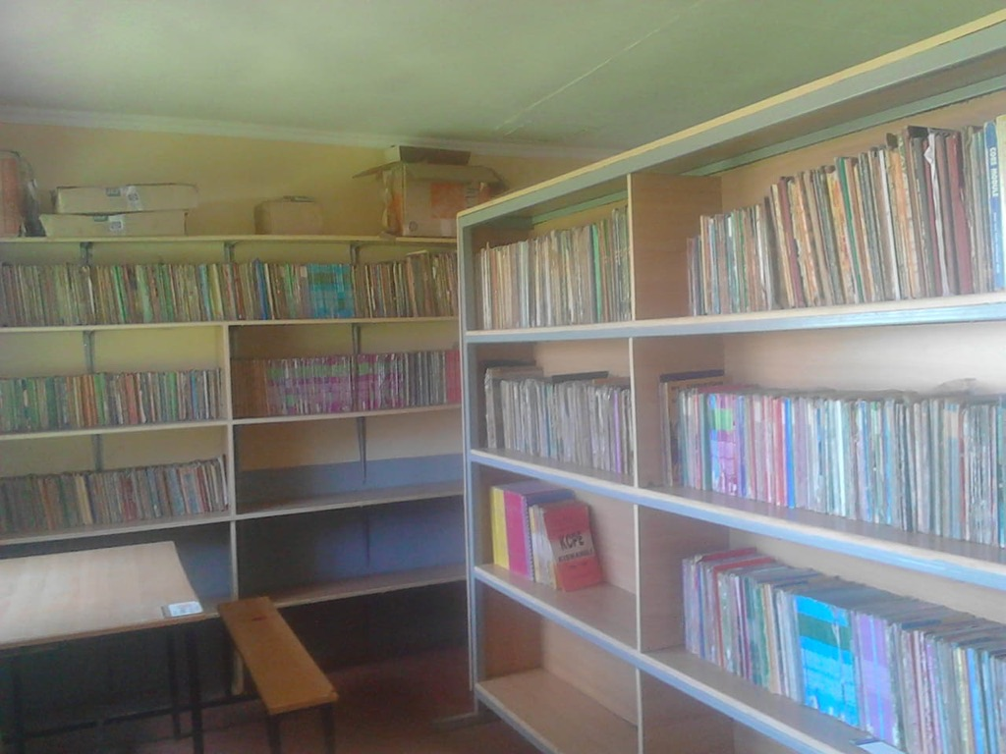
… this is the Kisiriri school library today

Slide 28
Welding at Tiziano Vocational

Slide 29
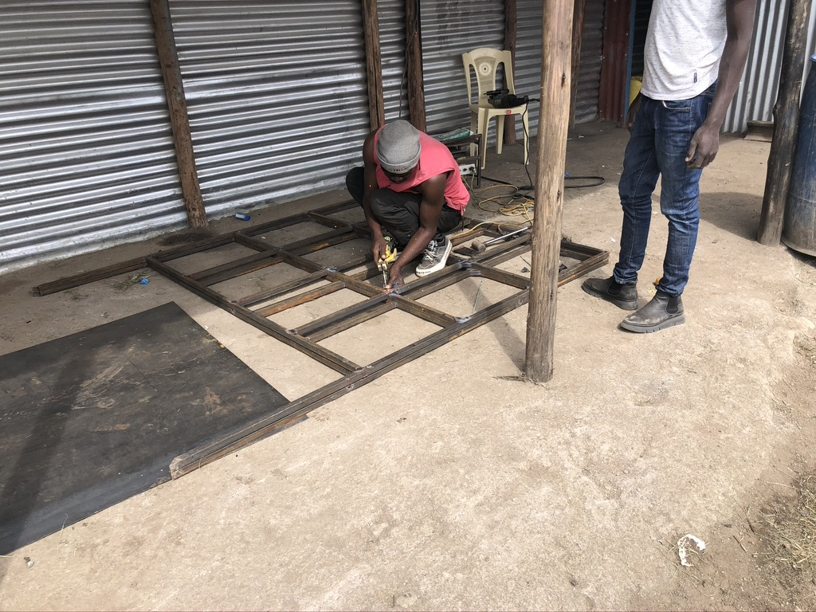
… poor tools and unsafe conditions

Slide 30
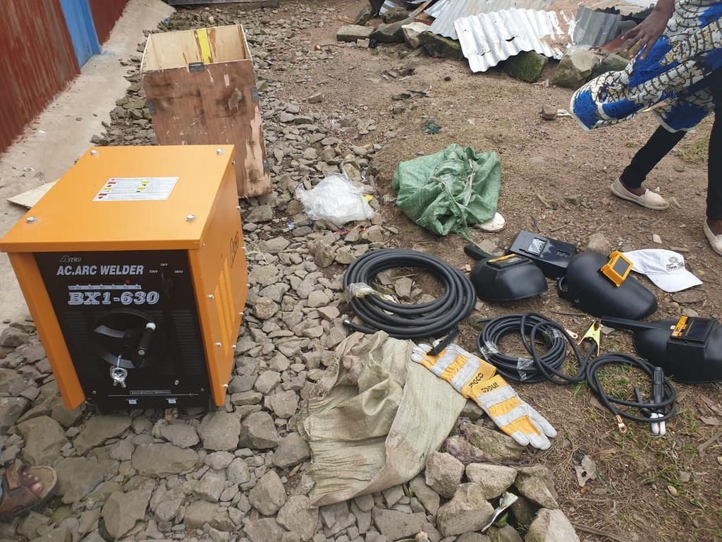
… new equipment and protective clothing

Slide 31
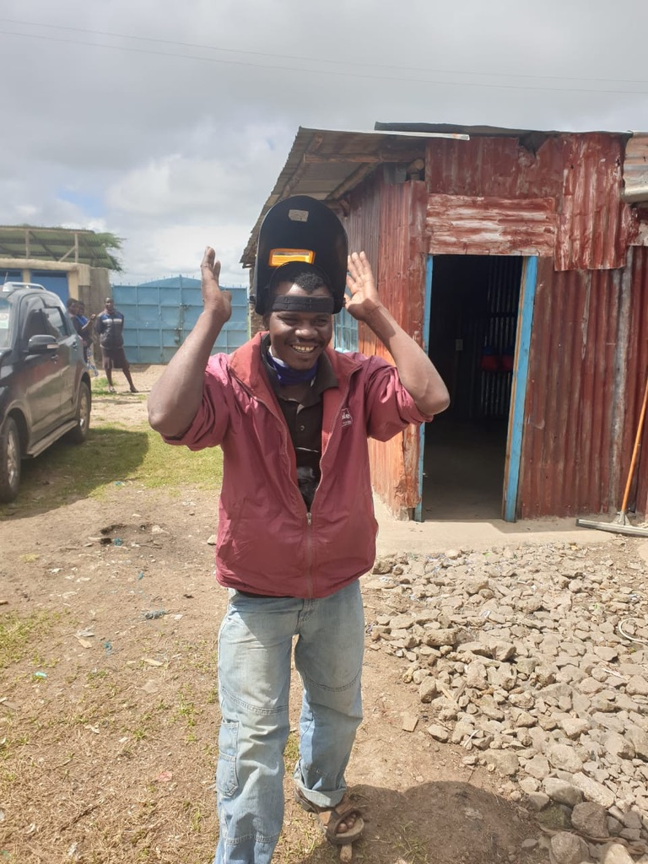
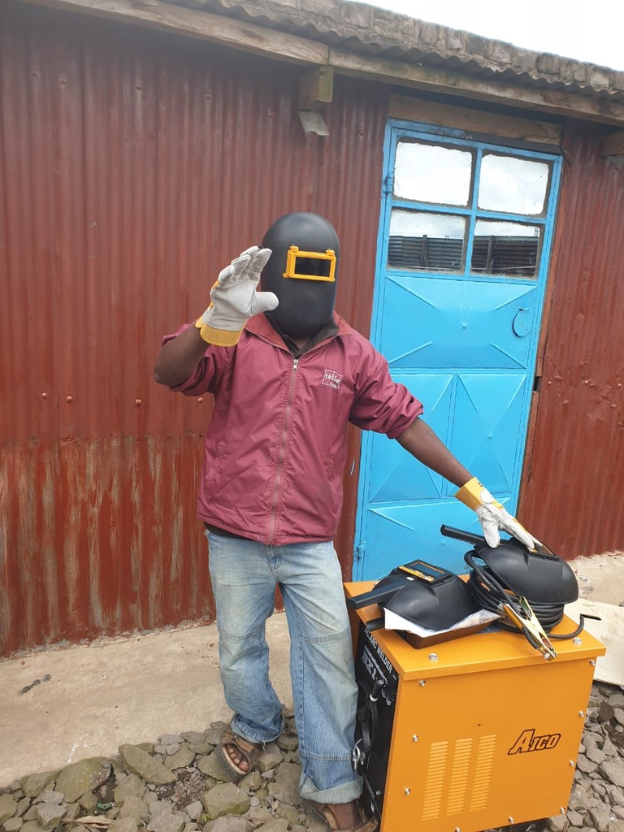
… improved quality and safe conditions

Slide 32
Sewing at Tiziano Vocational

Slide 33
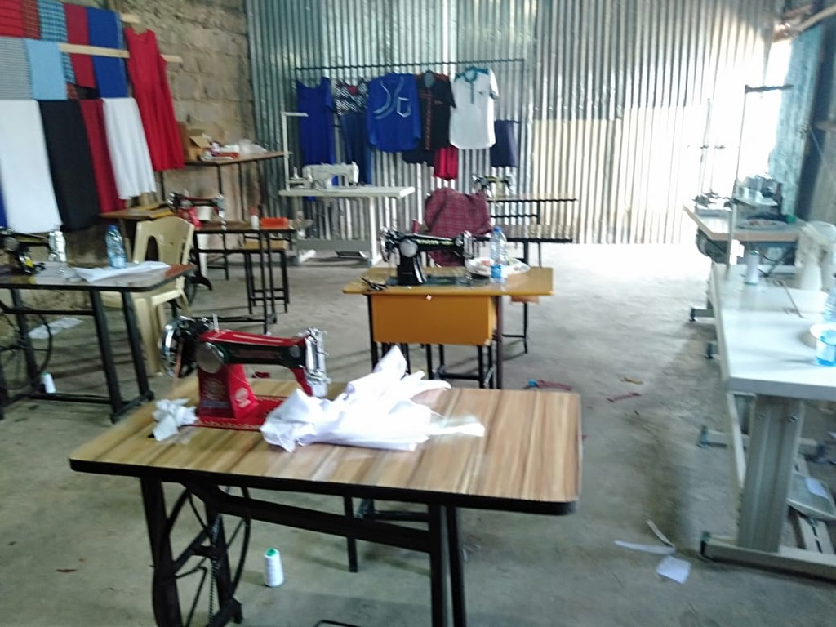
… nine sewing machines

Slide 34
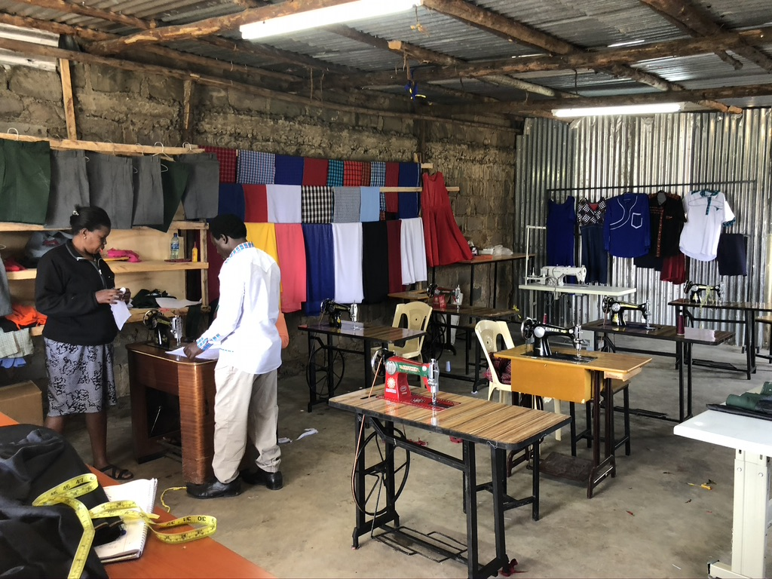
… making custom clothing and school uniforms

Slide 35
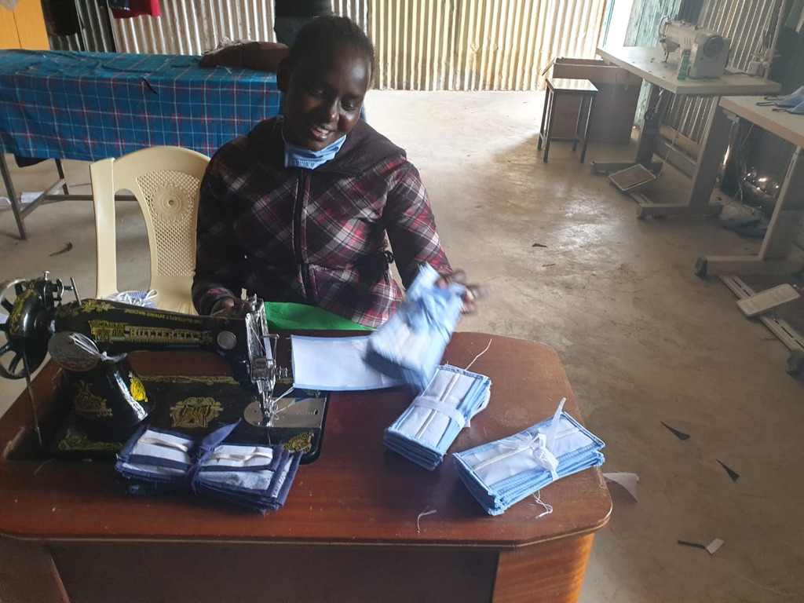
… masks to help in a crisis

Slide 36
Computer Lab at Tiziano Vocational

Slide 37
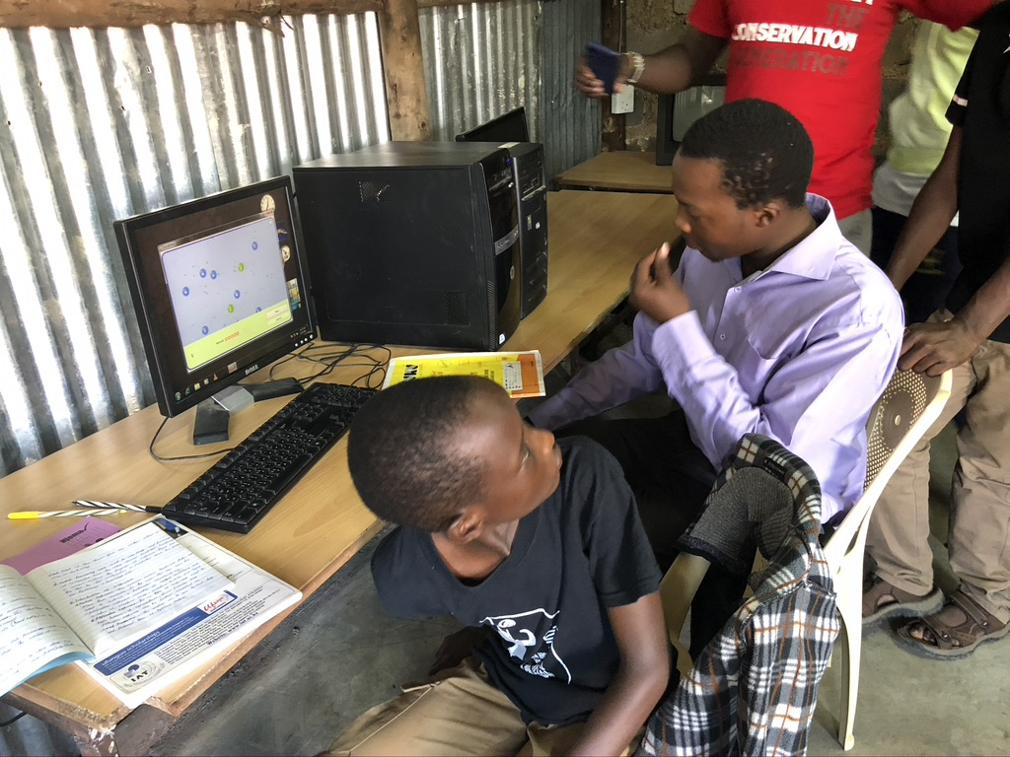

Slide 38
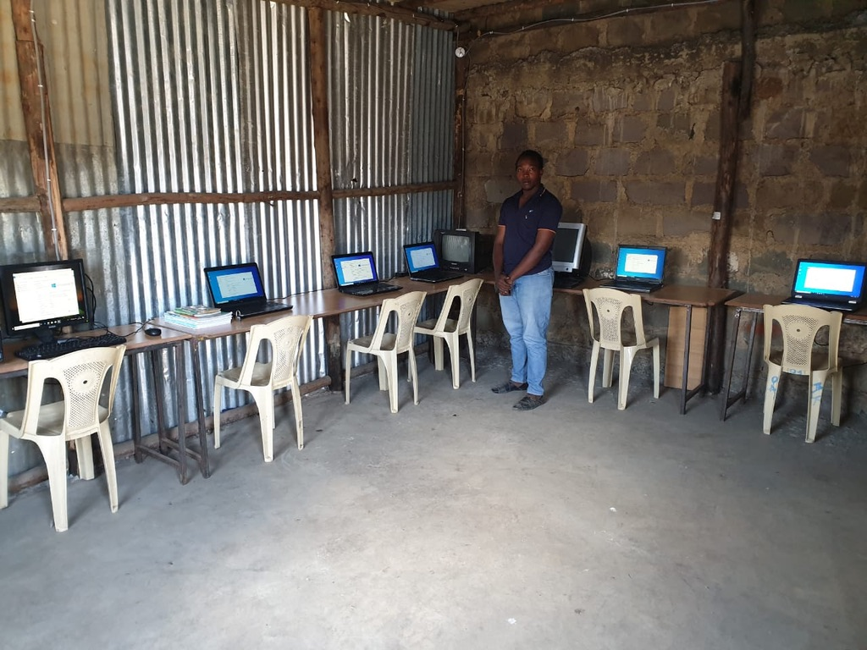

Slide 39
The rest of the story…

Slide 40
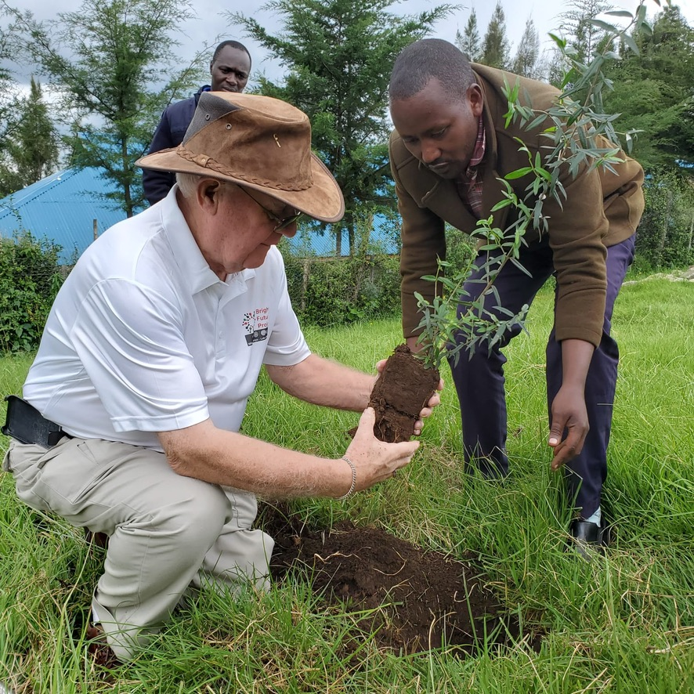
… if you visit you plant a tree

Slide 41
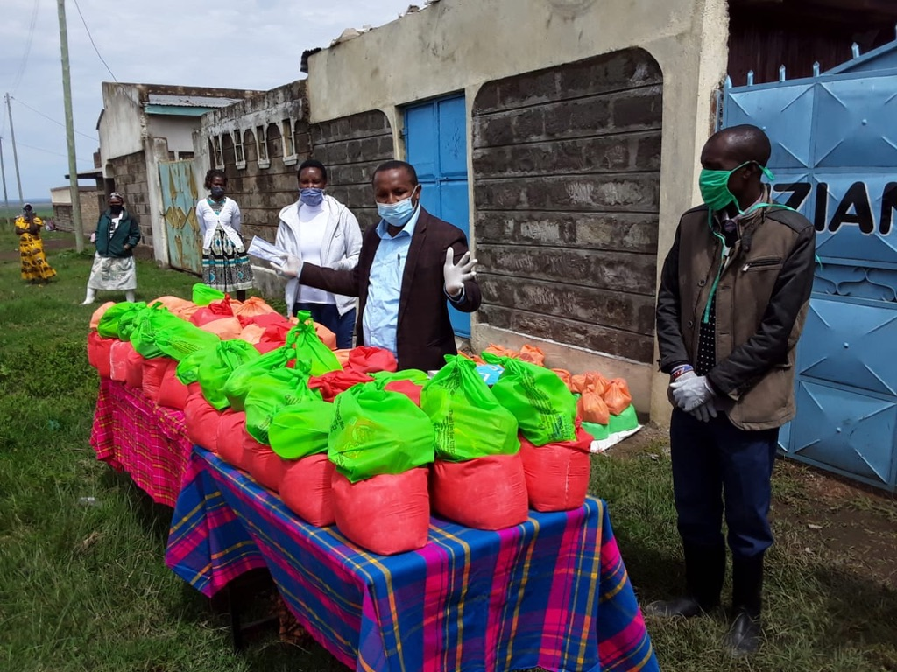
… feeding the poor, elderly and the frail

Slide 42
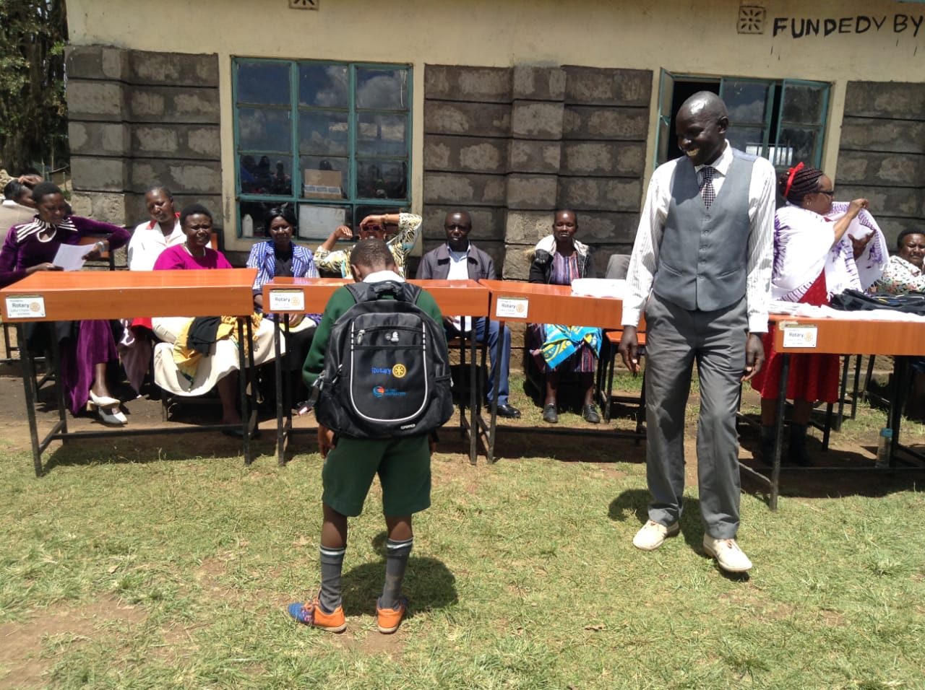
… student recognition

Slide 43
What’s Next

Slide 44
replace Kisiriri elementary school classrooms
build 300 school desks – 50 tables – 250 chairs

Slide 45
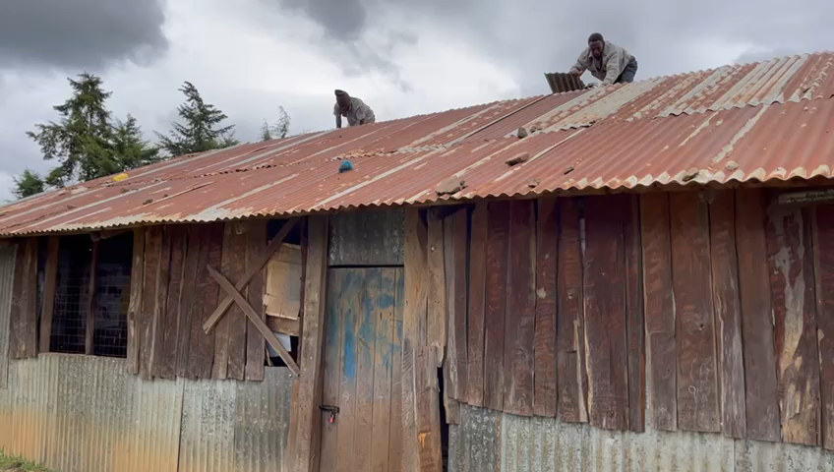
… old kindergarten classrooms

Slide 46
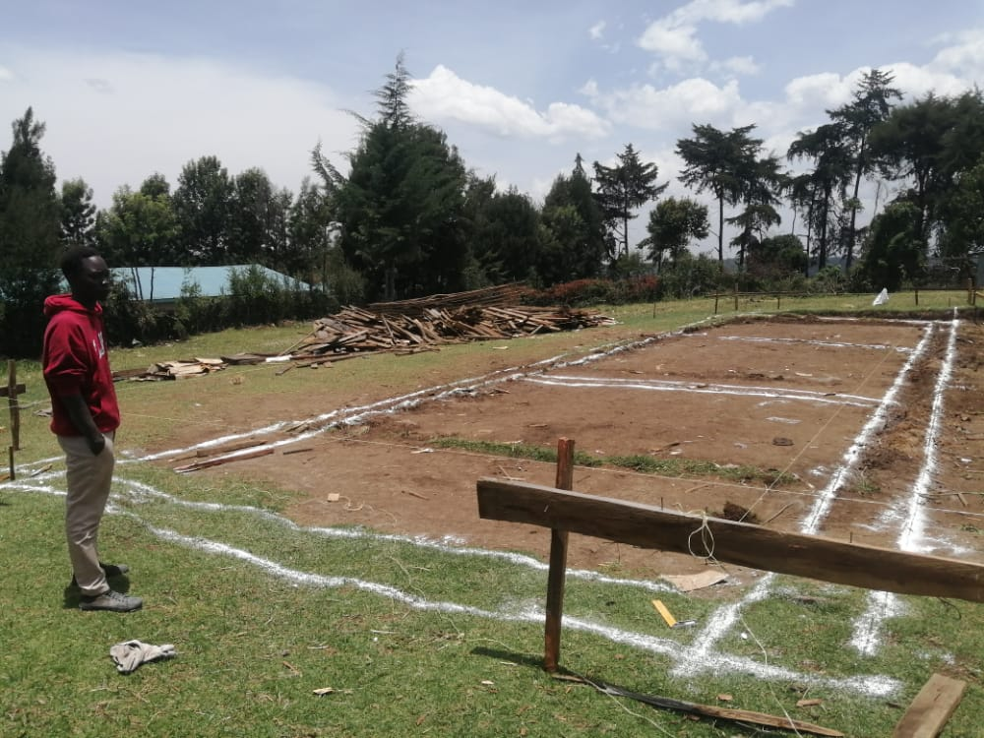
… old demolished and new foundation layout

Slide 47
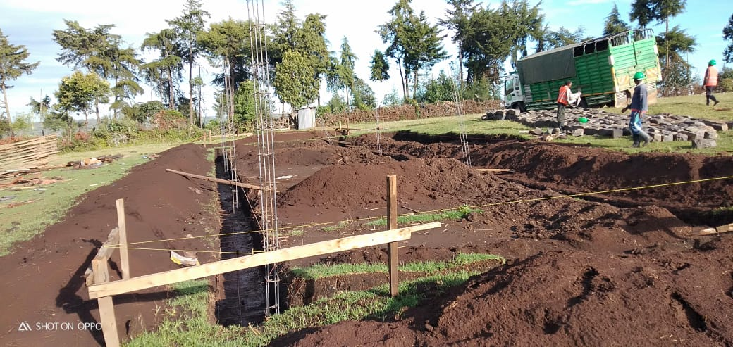
… local contractor and labor

Slide 48
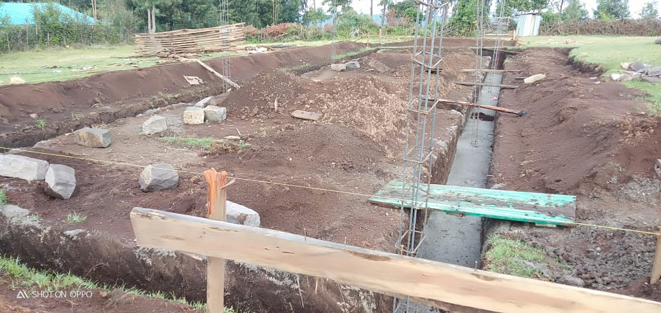
… progress on the foundations

Slide 50
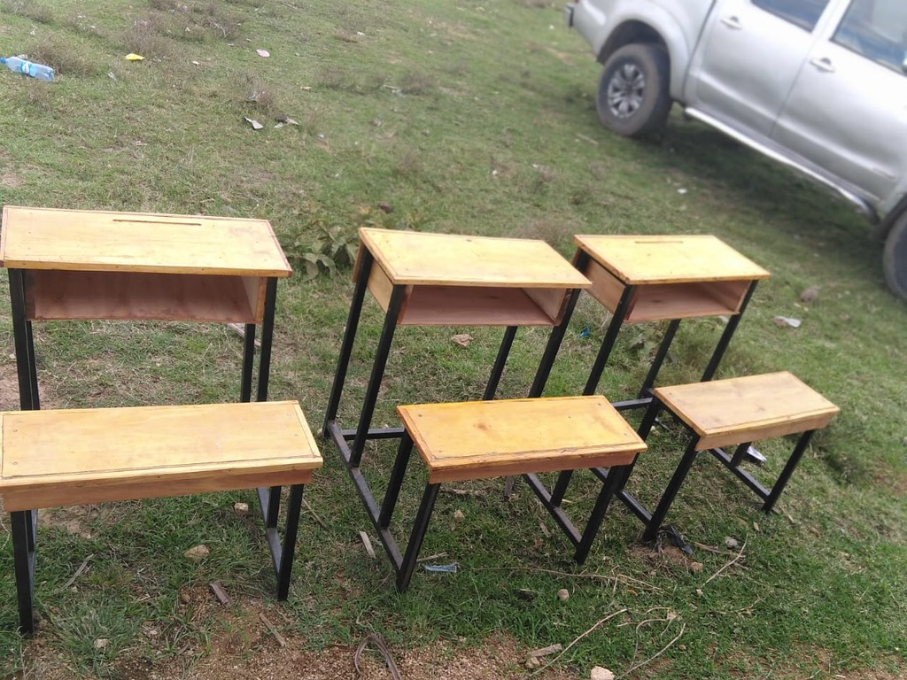
… we need 150 kindergarten desks
… for each desk donated we will provide a one for one match

Slide 51
replace Kisiriri elementary school classrooms
build 300 school desks – 50 tables – 250 chairs
continue to send books to school libraries
continue to support 6 girls in university
continue to support 21 girls and 4 boys in Nkoilale primary school

Slide 52
continue to support 3 students in secondary
support the building of a 600,000 ltr. water tank for Nagaswani hospital (possibly using a GG)
support the renovation of lltamaro primary school maybe with the help of a GG

Slide 53
Brighter Futures Project
Questions?

